Slide 1
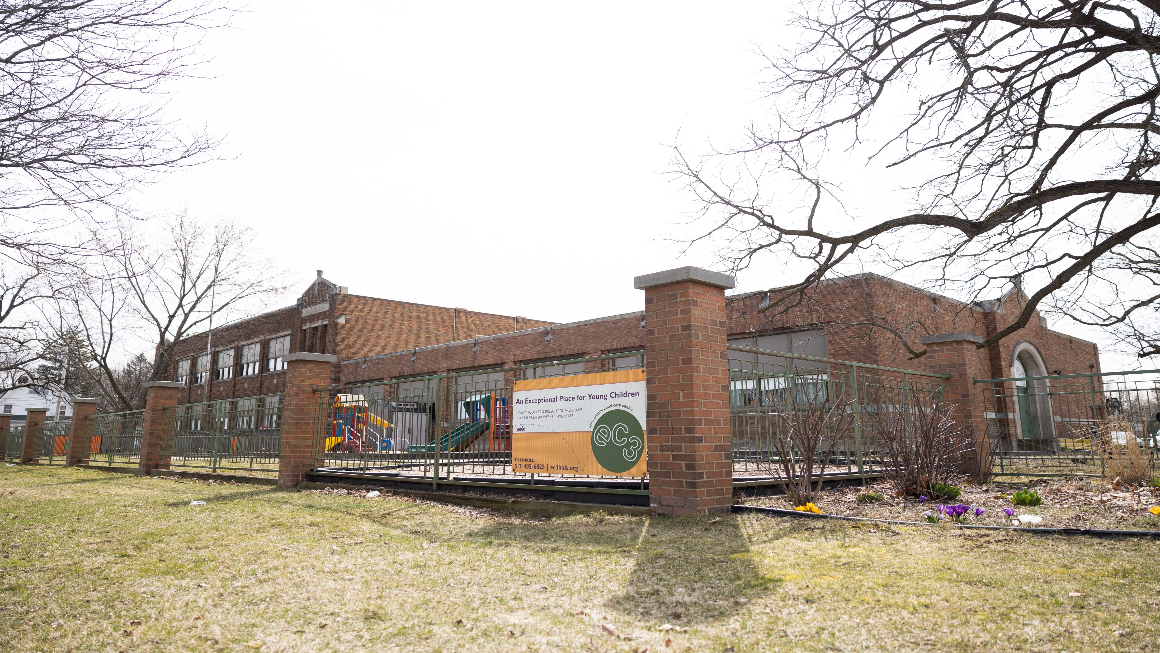

Educational Child Care Center
EC3
ANNUAL
REPORT
2025

Slide 2
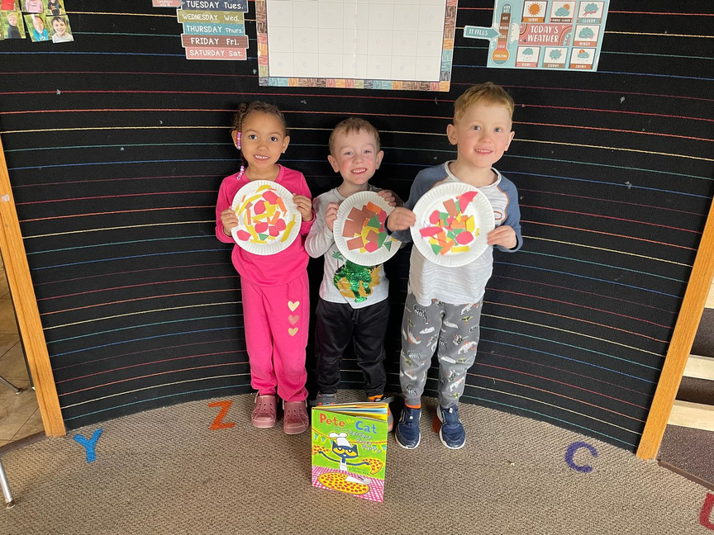
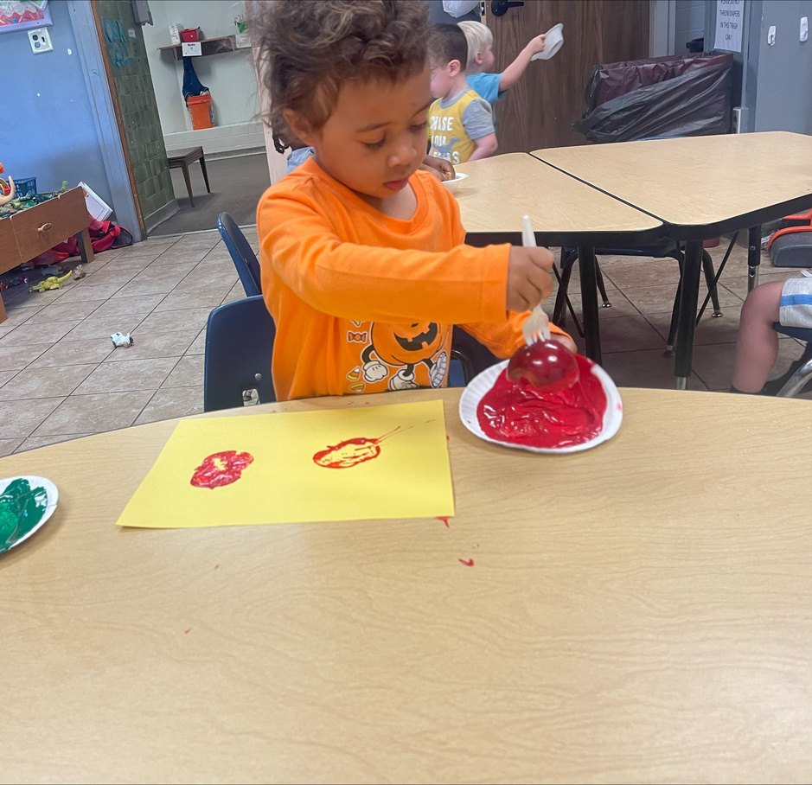
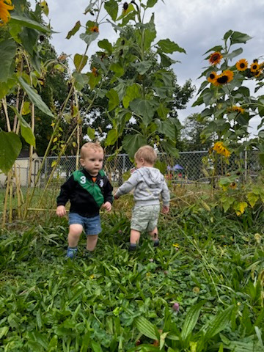

OUR MISSION
Provide developmentally appropriate childcare in a nurturing environment that promotes growth of the whole child while responding to the needs of the family.

Slide 3
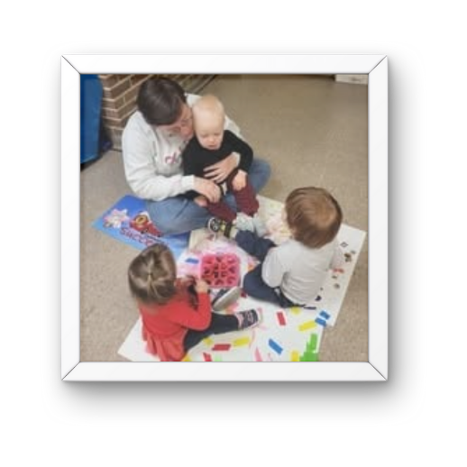
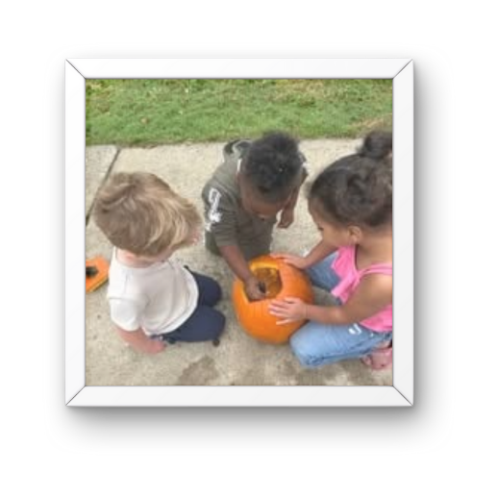
CONTENTS
Staff/Administration/Board of Directors
A message from our Board Chair
A look back on the year
24-25 Financials
A Bright Future Ahead
Donors/Grant Makers/Corporate Sponsors

Slide 4

OUR AMAZING STAFF
At EC3, our staff are the heart of everything we do. Their creativity, dedication, and genuine love for children shine through each day as they nurture curiosity, foster growth, and create a warm, welcoming environment for every child. From developing imaginative activities to offering comfort and encouragement, our teachers and caregivers bring joy and inspiration into every moment. Their commitment not only supports the development of the children in our care but also strengthens the entire EC3 community.

Slide 5
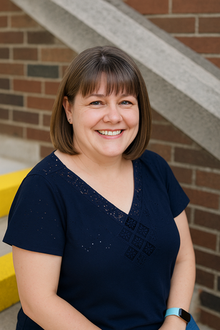
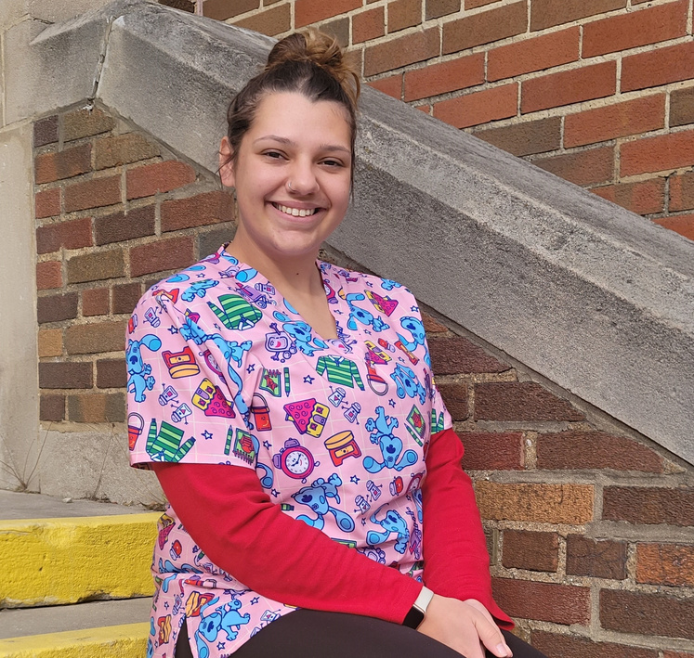
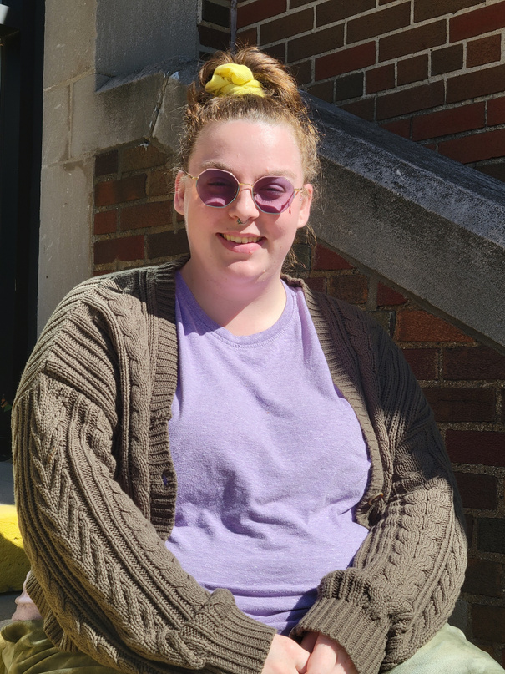


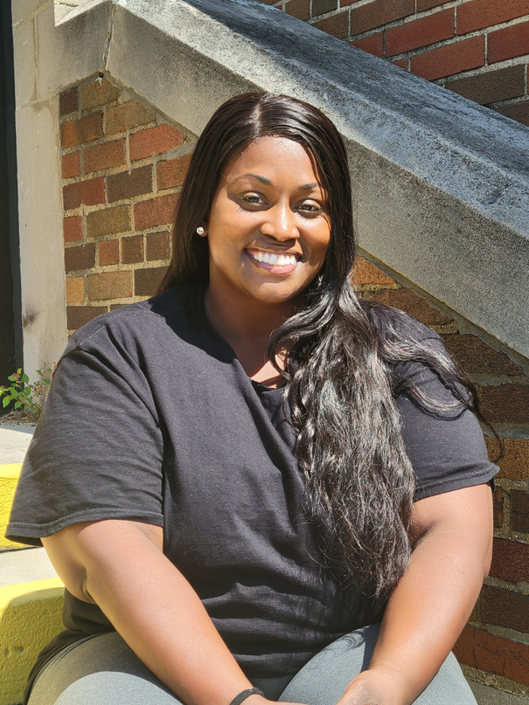

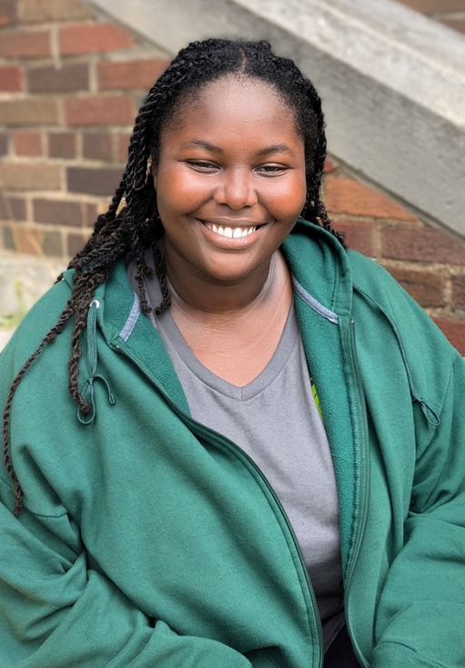
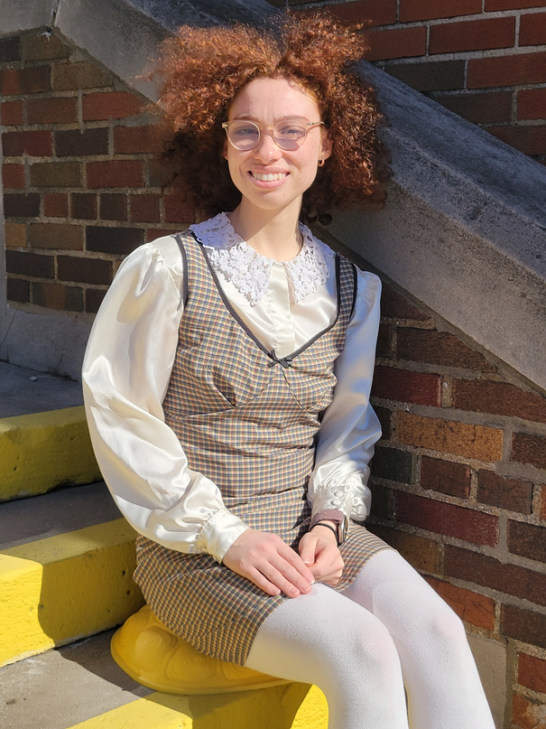
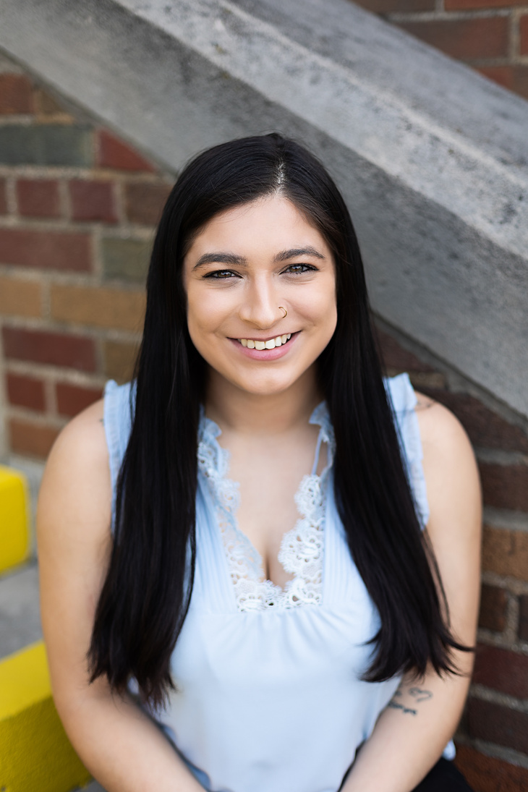

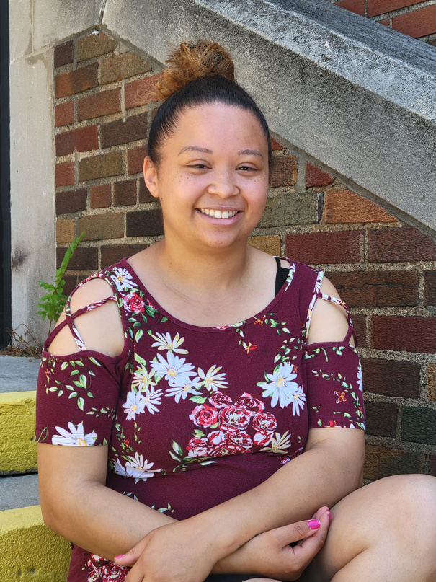
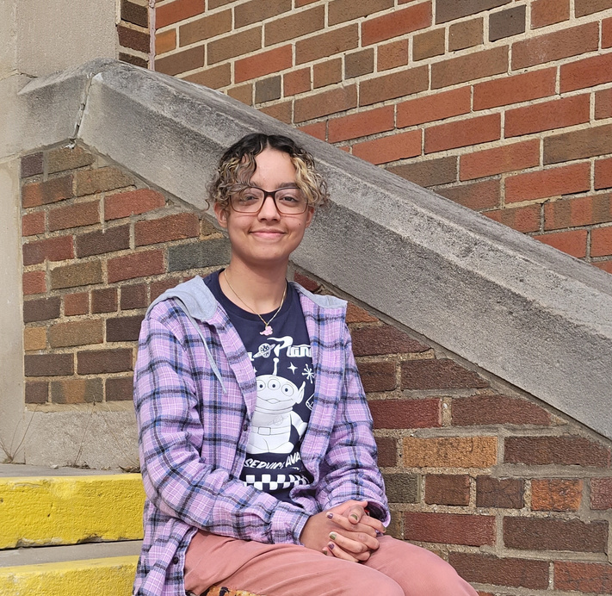
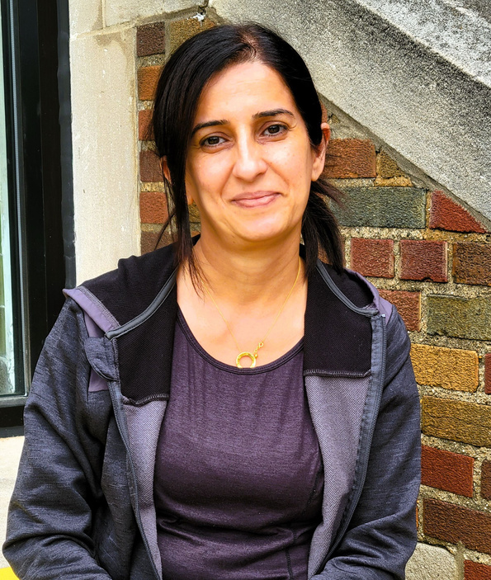
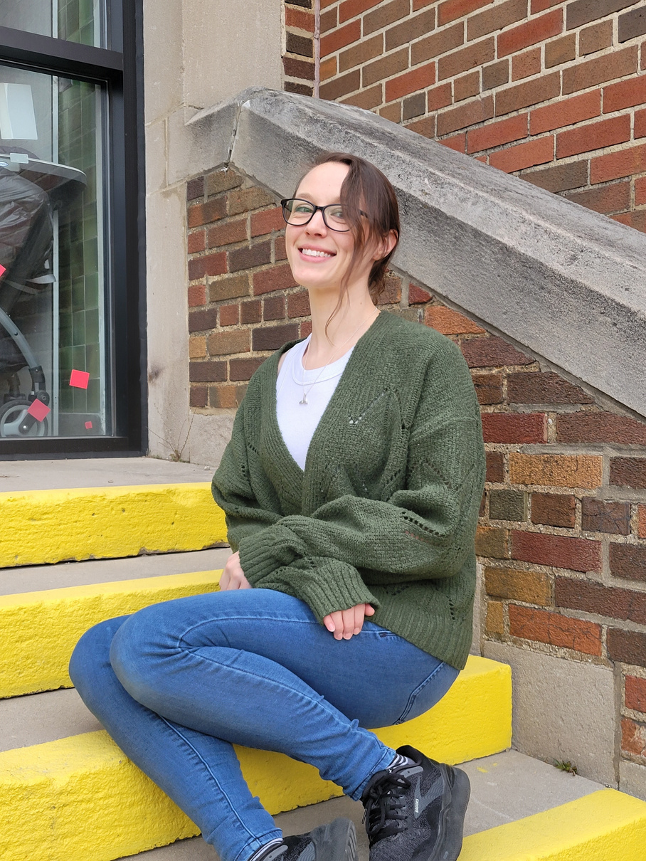
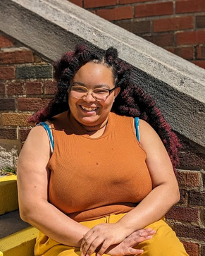

Infant
Toddler
Two’s
Christina
Abigail
Kimmie
Olivia
Mercedes
Latasha
Lali
Asante
Lili
Rocky
Dani
Victoria
Syrena
Ilham
Alex
Jaylen
Joanne

Slide 6
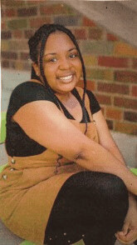



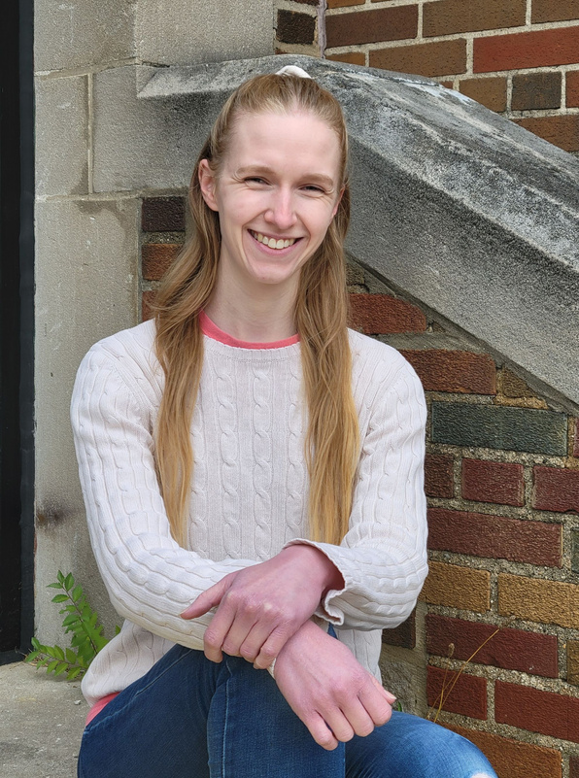
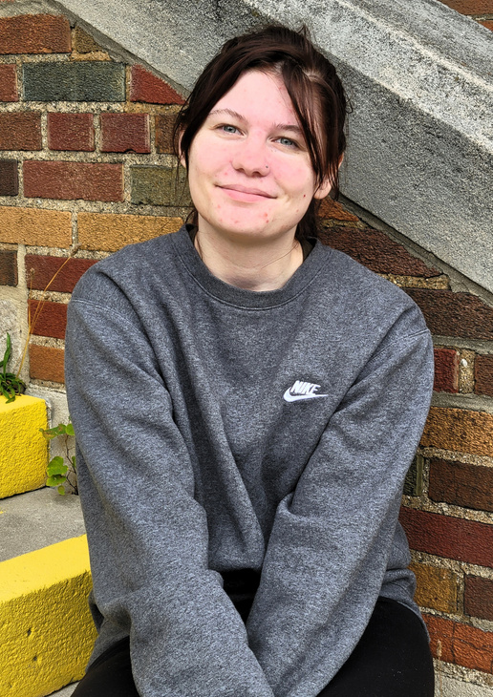
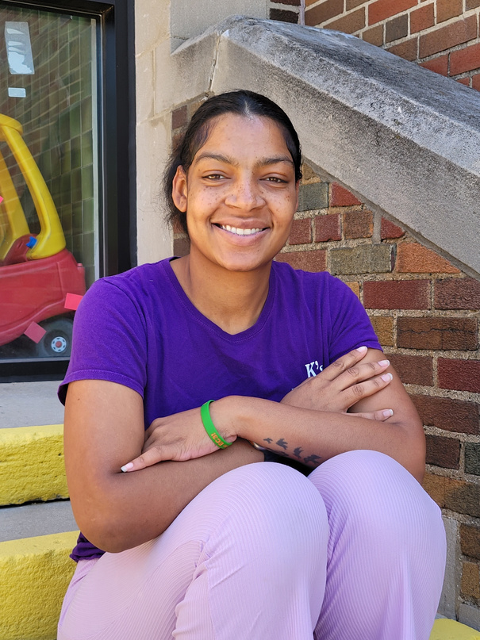


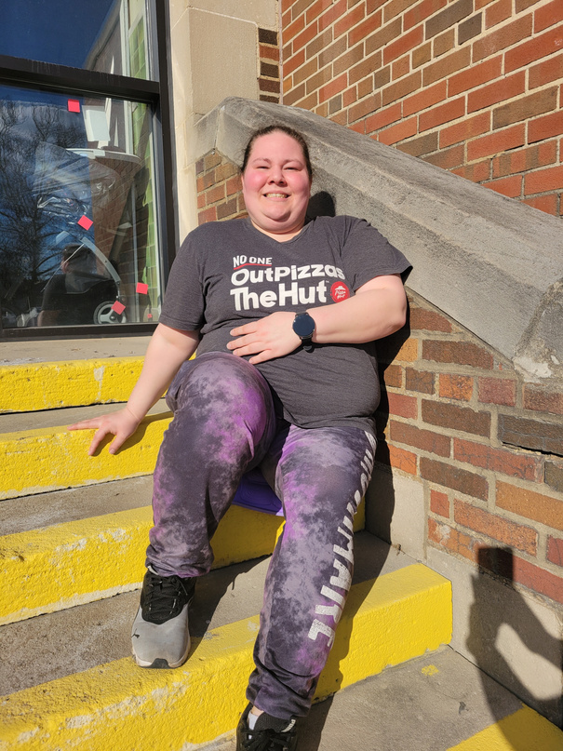
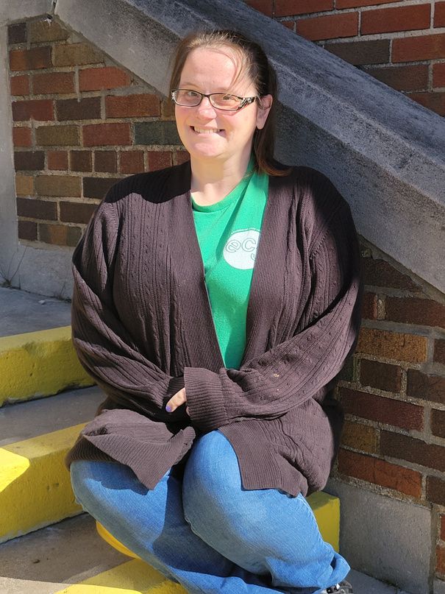

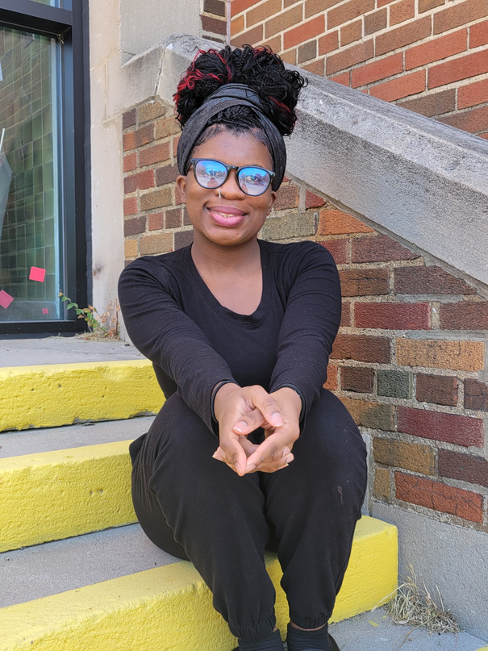
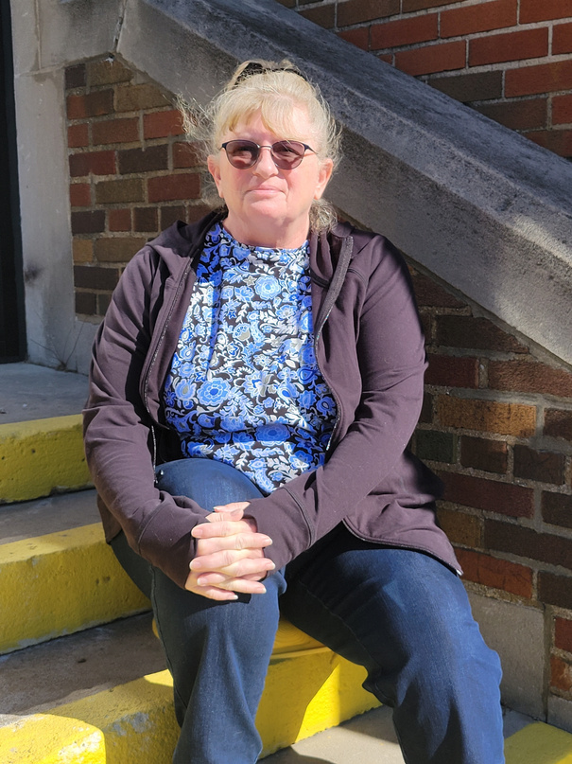

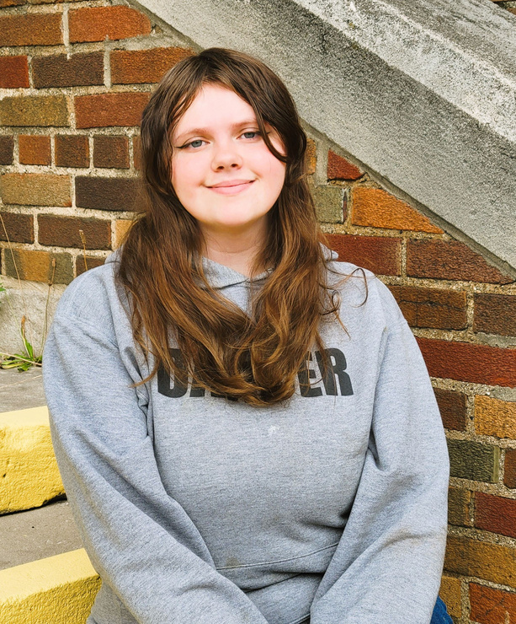
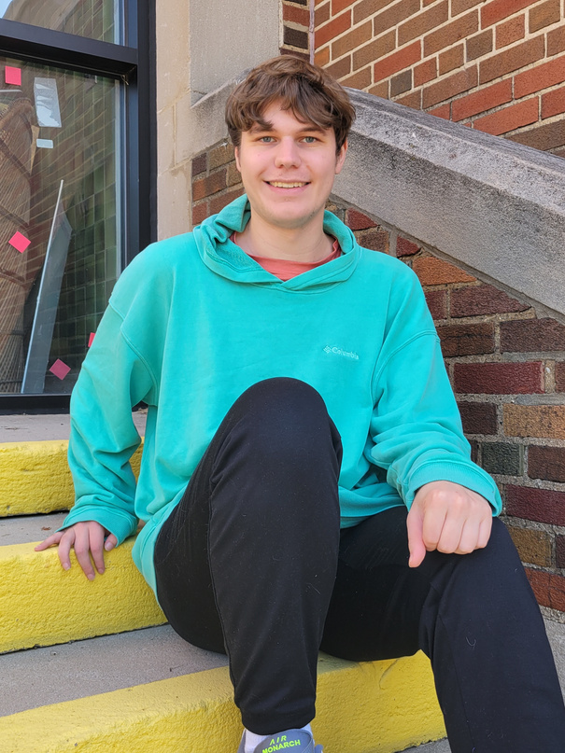
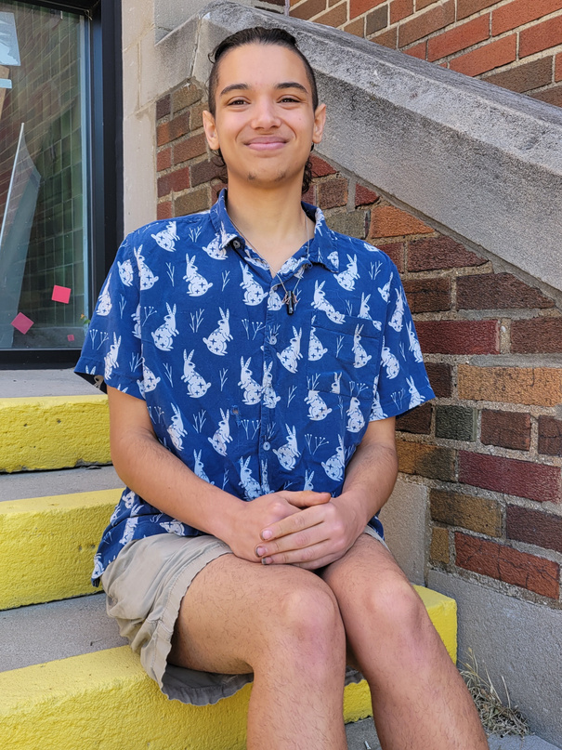

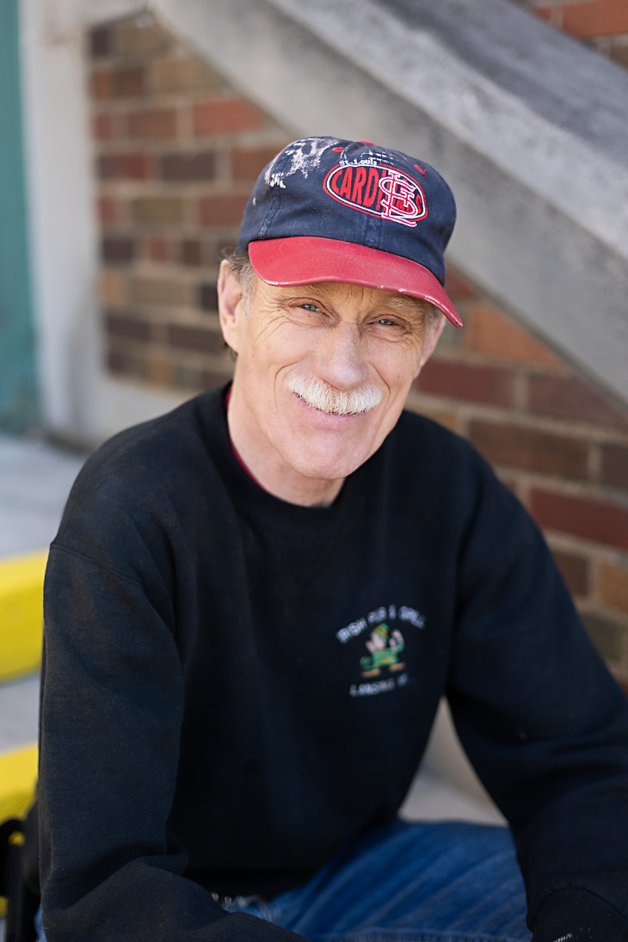
Preschool
Building Support
I’Resha
Carol
Burger
Tammy
Bridget
Anna
Brianna
Ronda
Ehricka
Breanna
Sarah
Katie
Ah’Keelah
Elaine
Taylor
Melady
Ben
Thorn
Becky
Roger

Slide 7
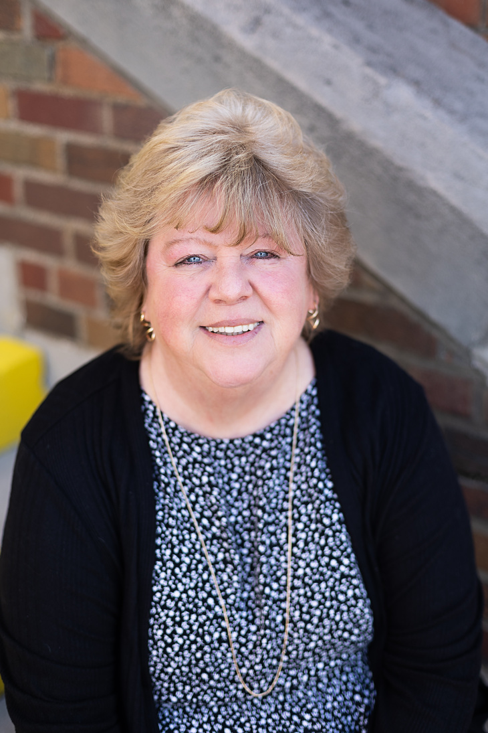
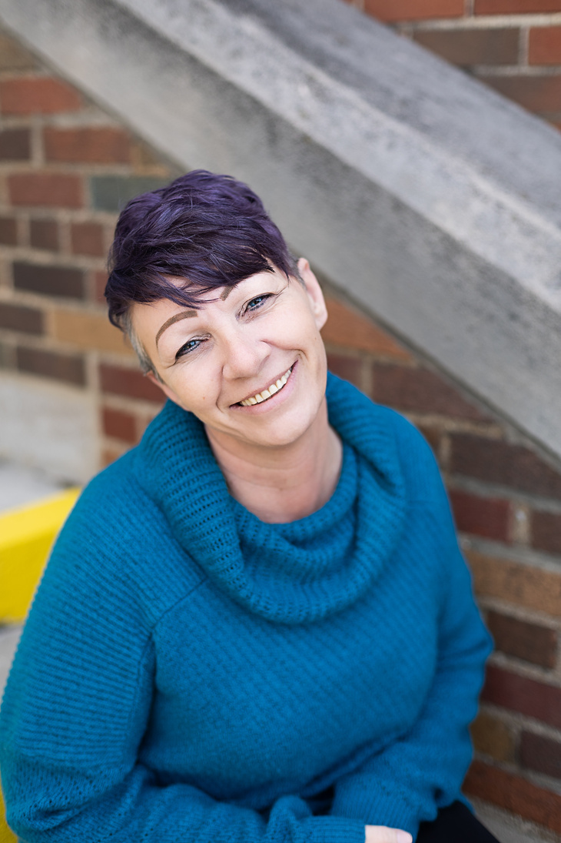

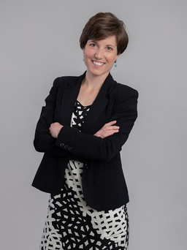
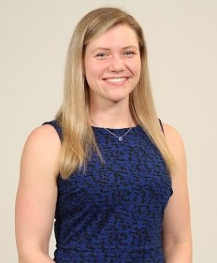

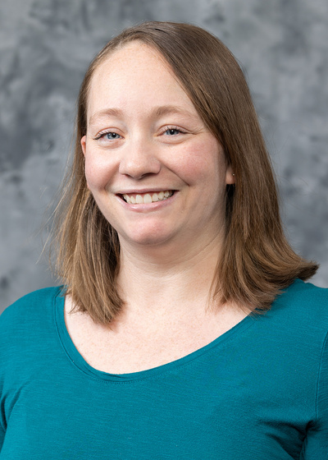
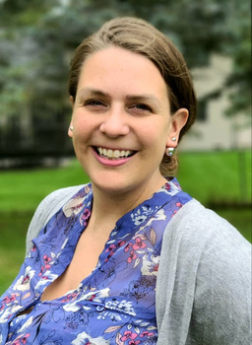

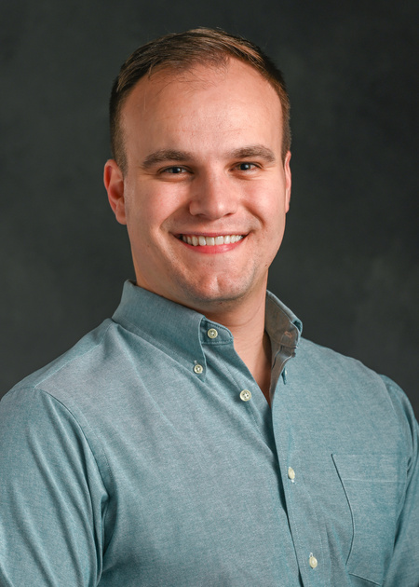
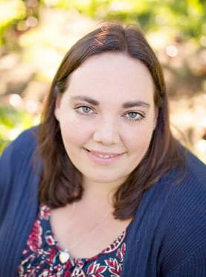
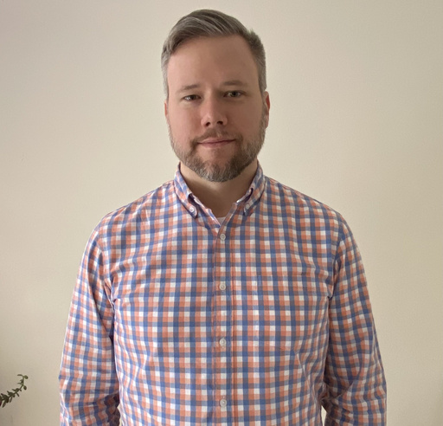
Administration
Board of Directors
Meghann
Board Chair
Jennifer
Vice Chair
Valerie Marchand
Secretary
Wanda
Program Director
Christina
Executive Director
Danielle Grubaugh
Treasurer
Jessica Morrison
Director
Christina Wichert
Director
Nate Caitlin
Director
Katie
Director
Dan
Director

Slide 8
A Fresh Start, A Shared Energy
First and foremost, I write to you as a parent of an EC3 child. Like so many of you, I’ve experienced firsthand the comfort of walking into a classroom where my child is known, encouraged, and nurtured each and every day. I’ve witnessed the dedication of teachers, the joy of learning, and the peace of mind that comes from knowing our kids are in a safe, supportive environment. That personal connection is what makes stepping into the role of Board Chair such an honor—it is not only about stewardship, but about giving back to the community that has given so much to my family in only a short time.
This year marks an exciting new chapter for EC3. We welcomed several new board members, each bringing fresh ideas and perspectives that complement the wisdom of our long-standing leaders. The mix of experience and new energy has already sparked thoughtful discussions and bold ideas for how EC3 can grow while staying true to its mission.
Like many organizations, EC3 faces rising costs and an increasingly complex environment for early childhood education. Staffing, facility expenses, and inflation all present real challenges. We are navigating these headwinds with transparency, careful planning, and creativity. At the heart of every decision is the question: How do we ensure the best possible experience for our children and families?
Despite challenges, the momentum is real. Enrollment is strong, partnerships are expanding, and families continue to be at the center of all we do. As a parent, I feel proud to know that my child is part of something bigger: a community that invests not only in the children of today, but in the foundation of tomorrow.
What makes EC3 truly unique is that it is a parent cooperative. This means that the strength of our community depends not only on staff and leadership, but on the active involvement of every family. Your voices, your time, and your talents are vital to sustaining EC3’s success. Whether you volunteer for a committee, attend a fundraising event, lend a hand at a classroom project, or share your skills in new ways, your engagement directly shapes the experience for all children.
I encourage every family to find a way to get involved this year. Not only does your participation make EC3 stronger, it also deepens your own connection with the community—and shows our children, by example, the value of working together for something bigger than ourselves.
I want to extend my heartfelt gratitude to the teachers and staff who pour their energy and passion into this work every day, to the families who entrust us with their little ones, and to the supporters who make our growth possible. Together, we are ensuring EC3 remains a place where children thrive, families feel supported, and our community grows stronger.
Thank you for walking this journey with us. I am excited for what lies ahead—and proud to serve, not only as your Board Chair, but as a fellow EC3 parent.
Meghann Keit-Corrion, Board Chair

Slide 9

Together We Grow
What an exciting and inspiring year it has been at EC3!
We’ve continued to make improvements to our building to ensure a safe and welcoming environment for every child and family. This year, we added security cameras in all classrooms, updated the hallway and classroom paint, installed new carpet in the hallways, and replaced the tile in the Gecko room. These updates help us create a space that feels both fresh and familiar—a true home away from home for our EC3 community.
Our programs also continue to grow and evolve. Summer Camp was busier than ever, especially with the addition of our new Pre-K Camp! We loved seeing our campers explore, learn, and make new friends all summer long.
We’re also proud to share that EC3 successfully passed our Great Start to Quality accreditation and maintained our Enhancing Quality validation—a reflection of our ongoing commitment to providing the highest quality early childhood education.
And perhaps most exciting of all, we’re gearing up to celebrate EC3’s 40th anniversary in 2025! As we honor four decades of caring for children and supporting families, we’ve expanded our community outreach through our monthly Community Connection events—bringing families, staff, and neighbors together to learn, share, and grow.
This year has truly been about connection, growth, and gratitude. Thank you for being part of the EC3 family and for helping us continue our mission of nurturing the whole child, every day.

Slide 10
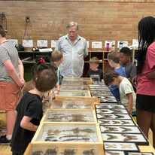
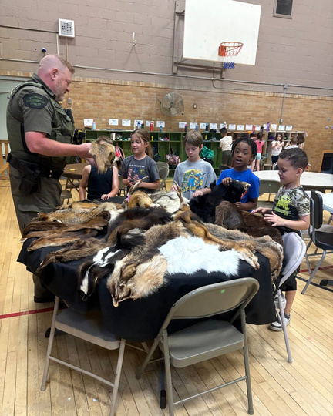
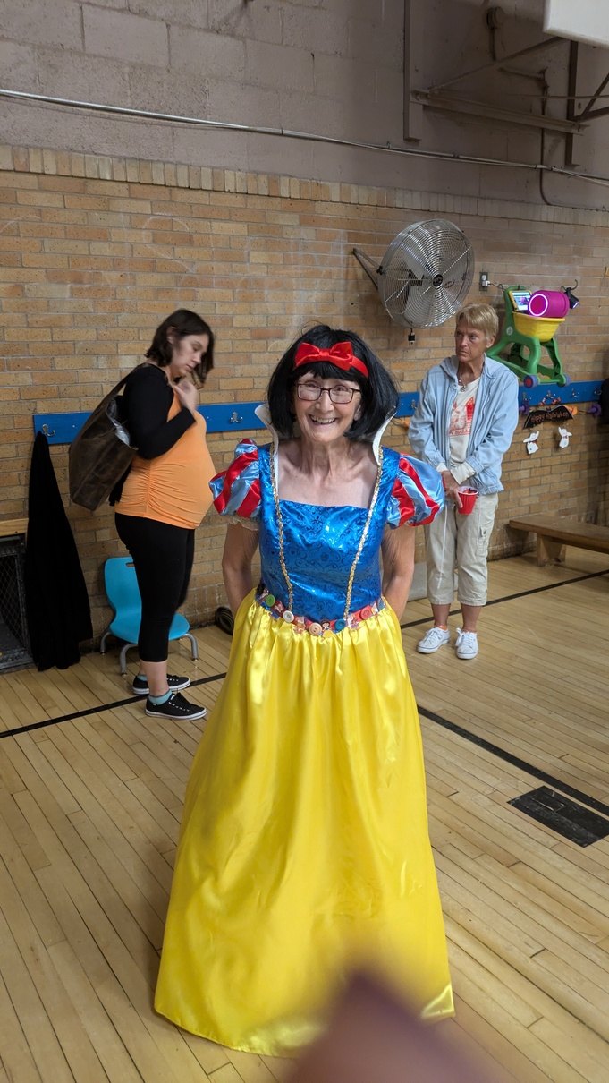
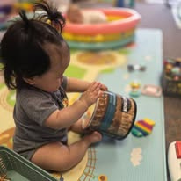
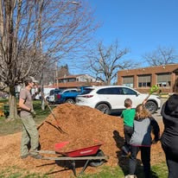
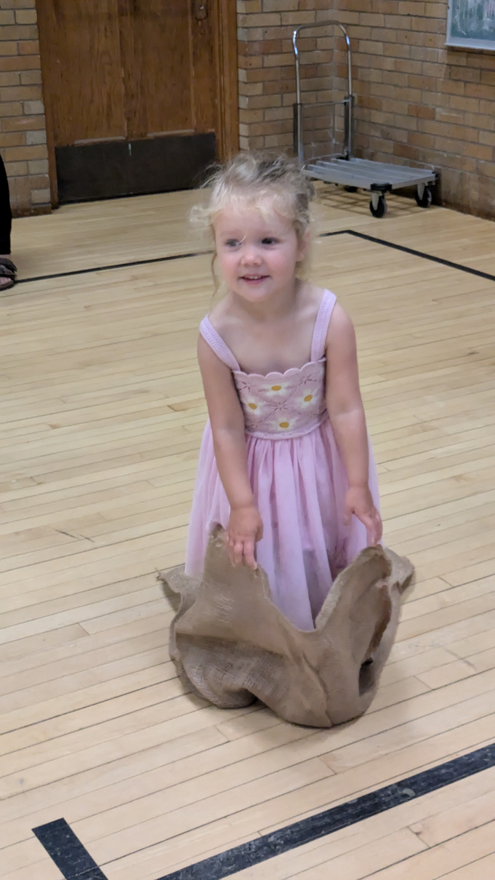
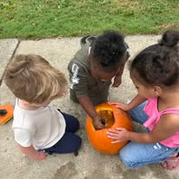
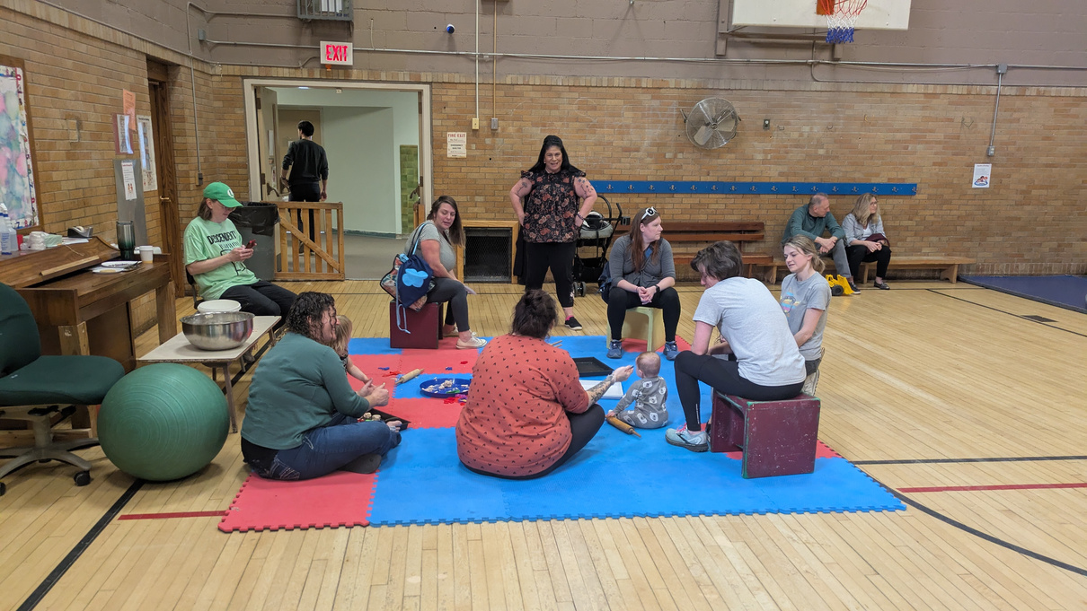
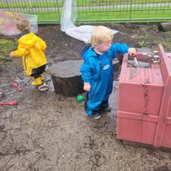
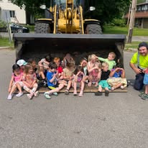
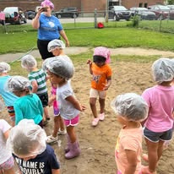




Slide 11


FY 25 Financials
14%
4%
Revenue
Expenses
82%
Employees-$1,401,468
Operations-$230,446.
Classroom-$67,077
Total Expenses-1,698,991
Tuition and Fees-$1,703,107.32
Donations, Fundraising and Other Income-$64,049.20
Total Revenue-1,767,156.52

Slide 12

FY 26 Budget
Projected Revenue-$1,857,991
Projected Expenses-$1,892,873

Slide 13
Looking Ahead
GSRP – Free Pre-K Classroom
Thanks to Michigan’s Pre-K for All program, all children who turn four before December 1st will soon be eligible for free preschool! We anticipate being awarded 20 slots for a five-day-a-week GSRP classroom, expanding access to quality early learning for even more families in our community.
Lunches for All
We’re thrilled to share that once our new meal contract is approved, all EC3 students will receive lunch each day! This is an exciting step toward making healthy meals more accessible and convenient for families. Stay tuned for official start dates!
Building Repairs and Renovations
Our beautiful, historic building continues to grow alongside our program. We are currently conducting a building feasibility analysis to help us identify and prioritize essential repairs and improvements. This study will also guide us in reimagining spaces—adding restrooms upstairs, creating more classroom storage, and finding new ways to expand and enhance our programs.
And finally, our Infant & Toddler Sensory Garden is coming to life! Preparation will begin this spring, and we’re excited to add a sun shade structure to create a comfortable, engaging outdoor learning environment for our youngest learners.

